Slide 1
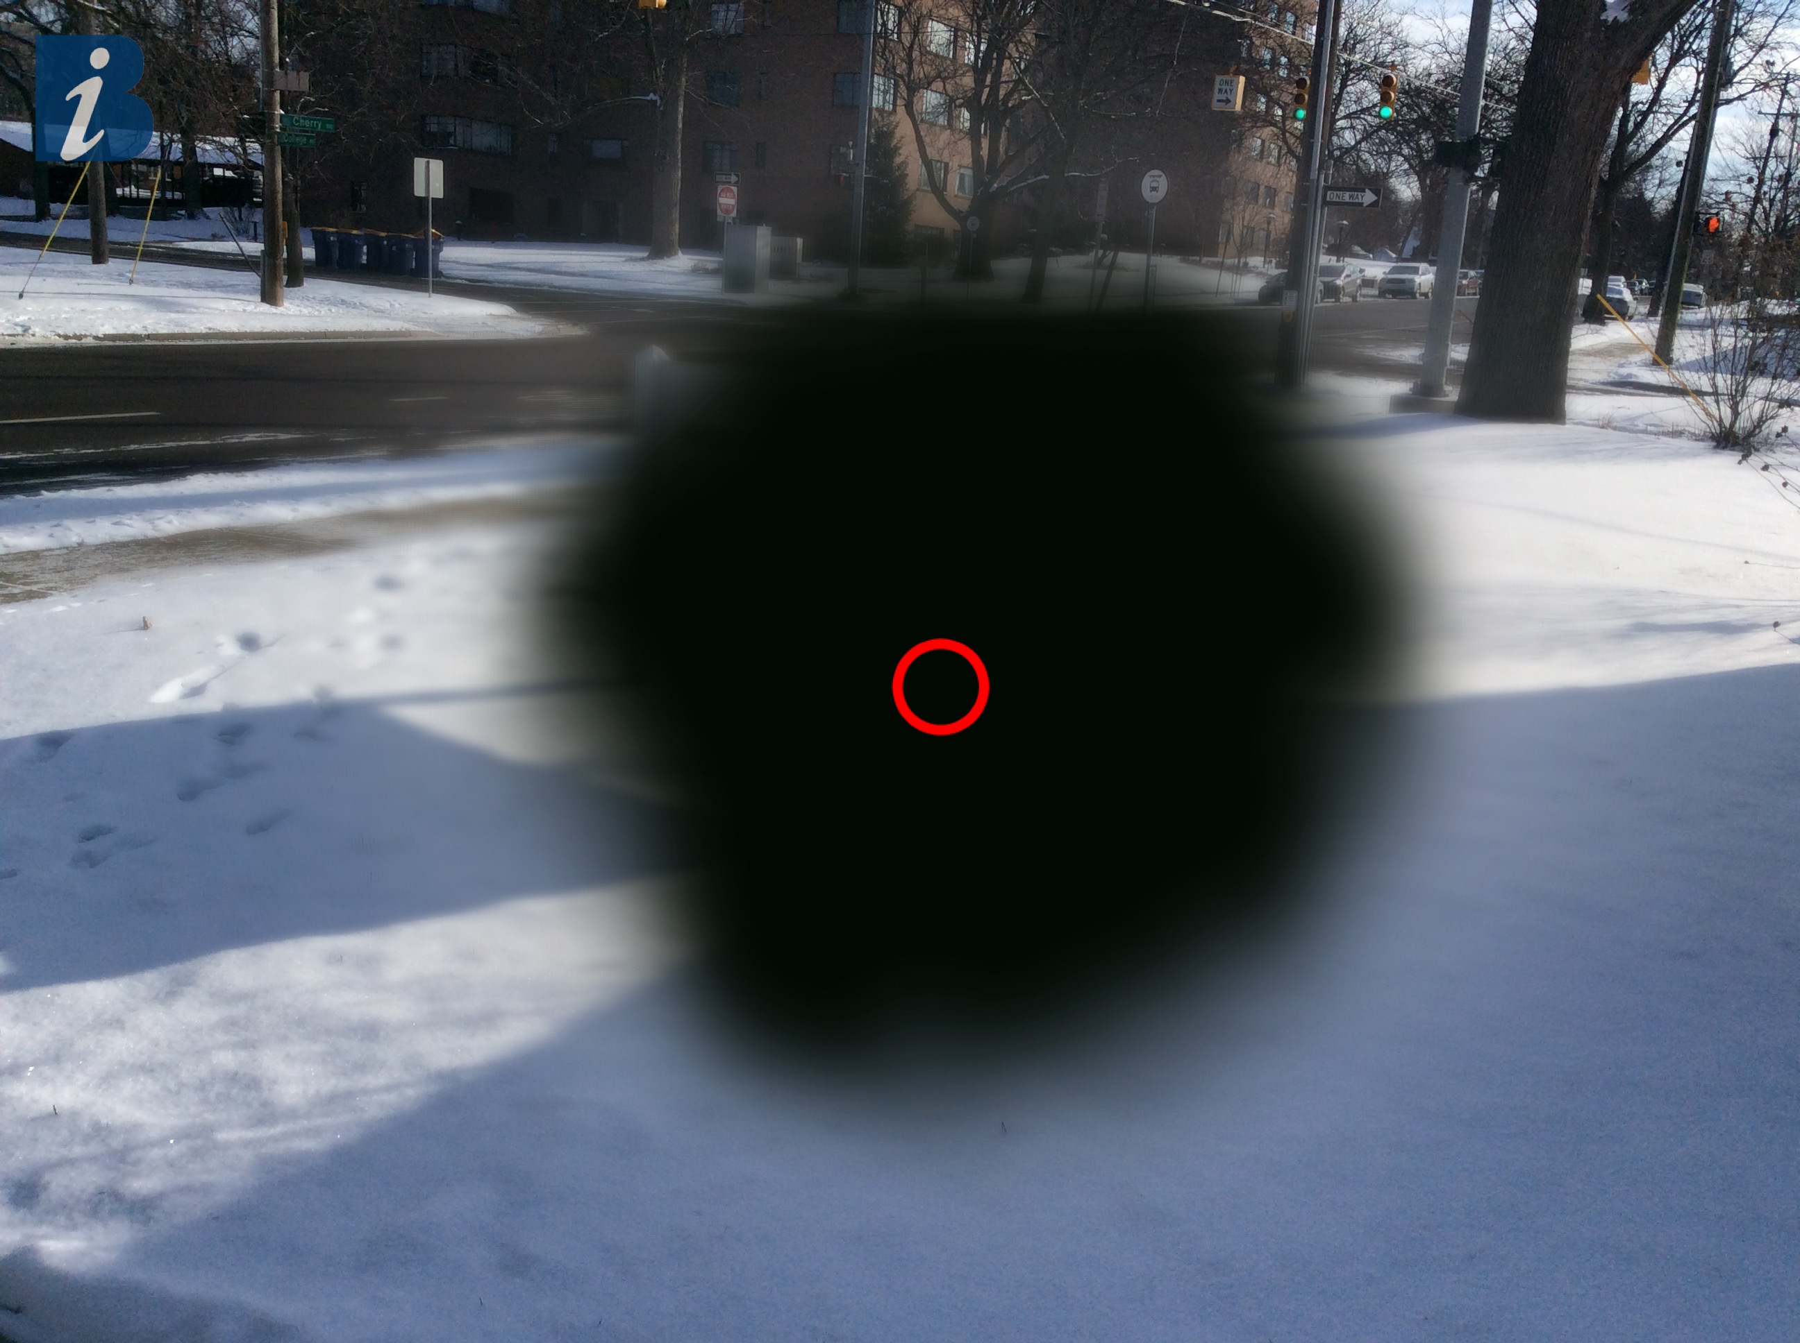
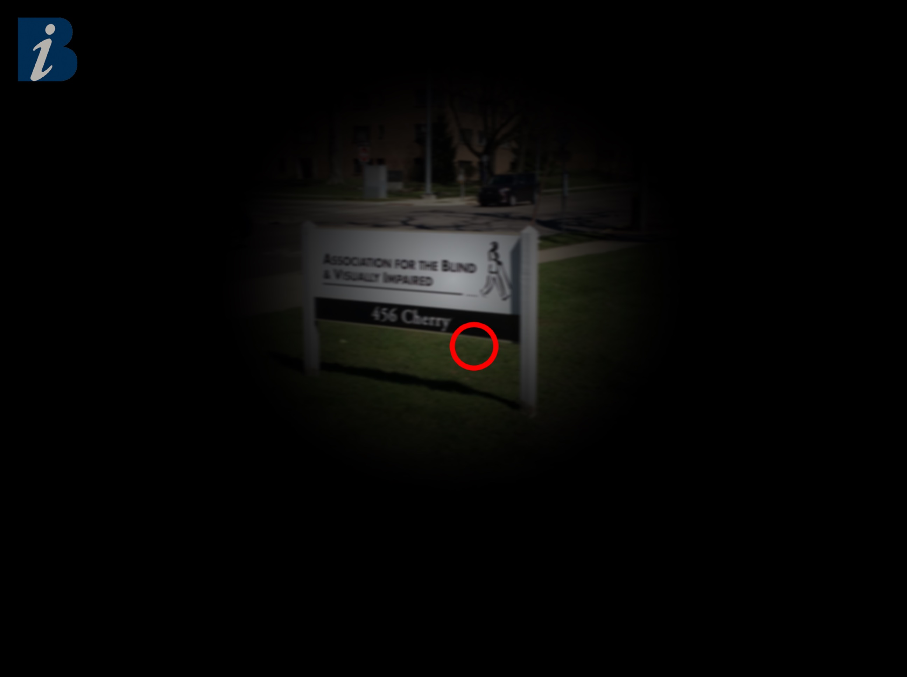
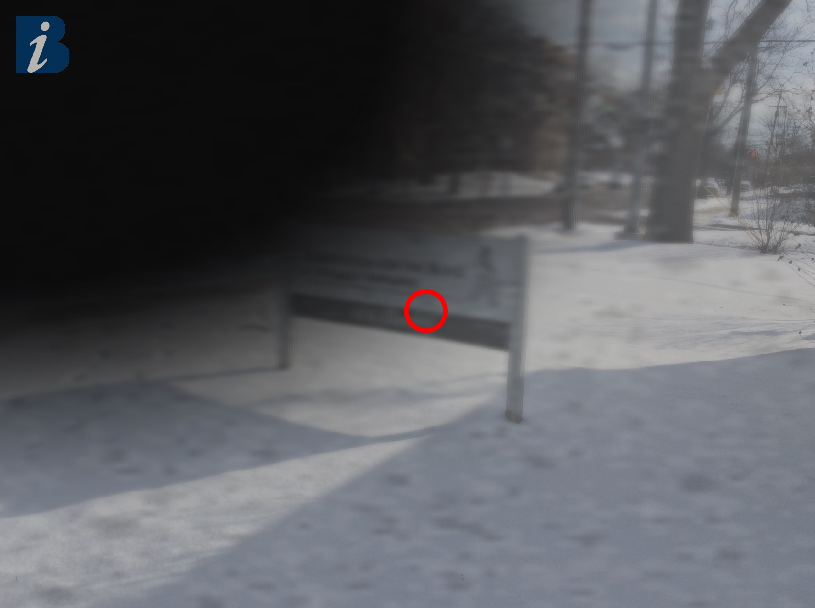
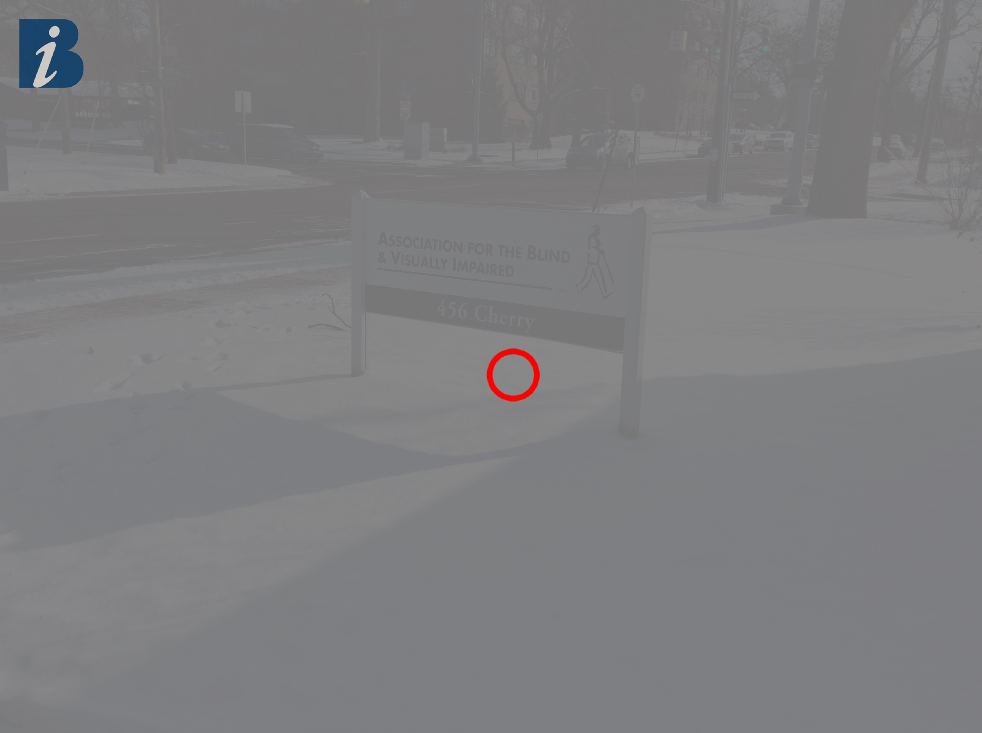
Utilizing Software Engineering and Cloud Computing Principles to Develop the Revised Self-Report Assessment of Functional Visual Performance
(R-SRAFVP) Application
Macular Degeneration⁽¹⁾
Glaucoma⁽¹⁾
CIS693 Final Project Presentation
Kirk Hedlich
Advisor: Byron DeVries, PhD
December 16, 2021
Diabetic Retinopathy⁽¹⁾
Cataracts⁽¹⁾
(1) Hedlich, Chris. “Eye Condition Examples”. 2017. JPG.
Notes:
Many types of unique eye conditions. Here are some common ones when growing older:
Age-related Macular Degeneration,
Glaucoma,
Diabetic Retinopathy,
Cataracts
To assess these types of conditions on daily activities, a standard assessment is needed.
This is how the Revised Self-Report Assessment of Functional Visual Performance comes into play
The R-SRAFVP assessment is used by medical professionals specializing in low vision rehabilitation

Slide 2
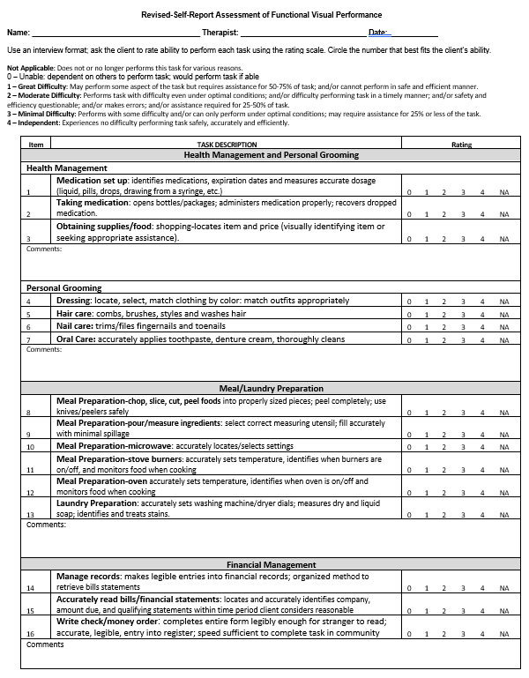
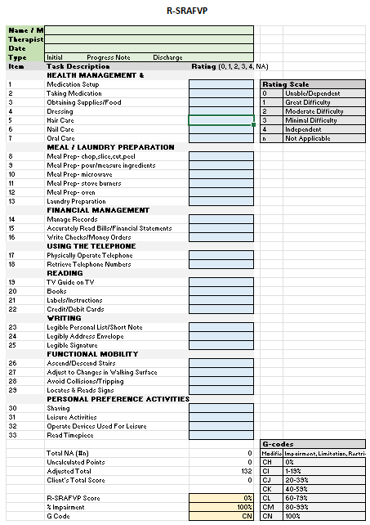
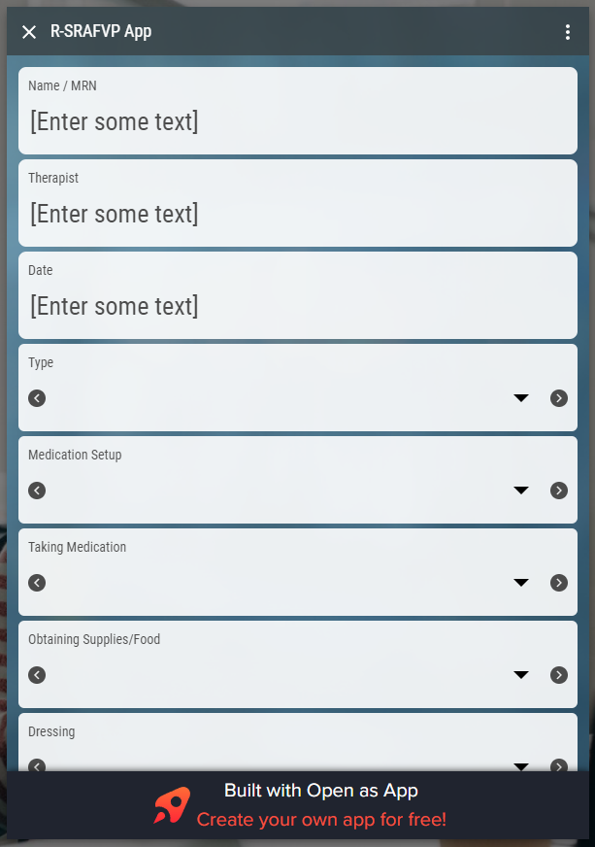
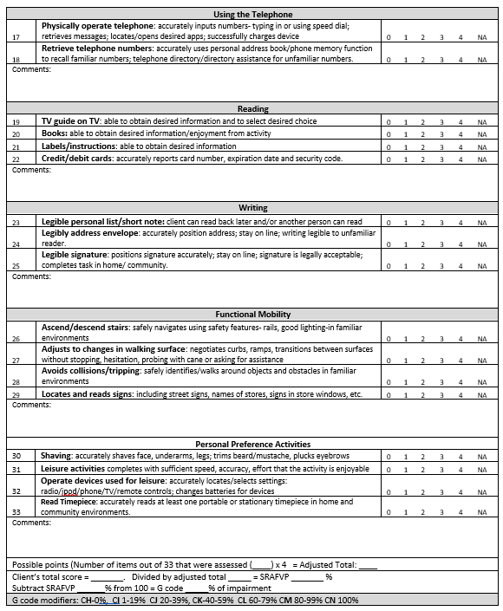
What are the current assessment methods?
Word processor/ PDF version⁽²⁾
Spreadsheet version⁽²⁾
R-SRAFVP App⁽³⁾
(2) “R-SRAFVP.” University of Alabama at Birmingham, 21 Feb. 2018.
(3) Mohiuddin, Omar. “R-SRAFVP App.” Open as App - Instantly Open Your Data as an App, https://www.openasapp.net/portal#!/client/app/ed9f4600-e824-4447-8d3f-5a550bf5c601.
CIS693 – Final Project Presentation
Kirk Hedlich, Dec. 16, 2021
Notes:
The R-SRAFVP was released in 2017 in two forms: Microsoft Word document and Excel spreadsheet
This assessments reviews a patient’s functionality across 8 main categories.
Each category contains several questions ranging from dealing with medications/food or personal grooming to reading, writing, and getting around without issue (e.g., tripping, going up or down stairs, etc.).
The question answers are based on the same rating scale. Zero represents completely unable to accomplish the task. Four means the patient is independent with the task. There is a safeguard answer of NA for questions unanswered or not applicable. The answers are tallied into an assessment score, level of impairment and Medicare code rating for treatment.
An attempt was made to make the Microsoft Excel spreadsheet version internet accessible. This was a wrapper application site around the spreadsheet.
Although each of these forms work on their own, the reasoning behind the new R-SRAFVP progressive web app is to
Reduce human error,
Simplicity of design,
Improve ease of use,
Greater accessibility,
Improve use/adoption,
Gather data to improve the assessment itself
Used Software Engineering principles for project management, process, artifacts (use cases, requirements, UI/UX design, models), and reviews

Slide 3
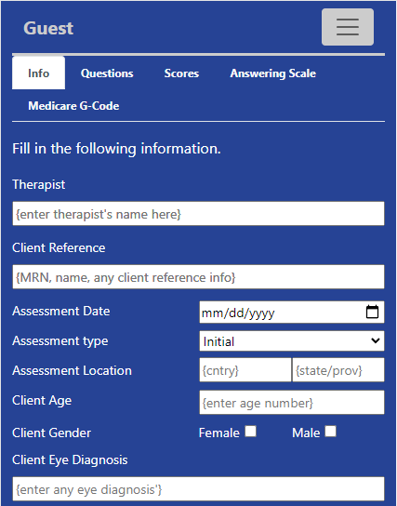
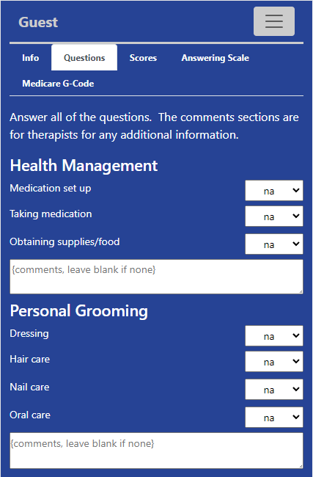
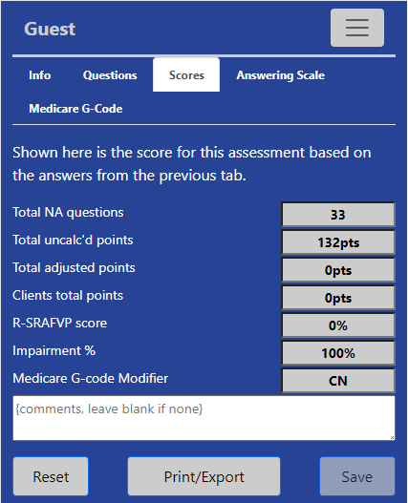
How does this project change the status quo?
CIS693 – Final Project Presentation
Kirk Hedlich, Dec. 16, 2021
Notes:
This project built a new R-SRAFVP application using Cloud Computing capabilities
A progressive web application
Discoverable on the web
Shareable
Responsive design
Security throughout
Progressive enhancement
Single code base across multiple device types and platforms
Uses cloud computing services
The main architecture for the progressive web application is
Hosting through Google sites
Firebase is used for the project and cloud services
Cloud services implemented are authentication, analytics and Firestore (no SQL database)
Core languages used are HTML, CSS and JavaScript
The progressive web application makes the assessment available to any medical professionals specializing in low vision rehabilitation
- Although Occupational Therapists specializing in low vision are the target audience.
There are a total of 11 webpages, but the core functionality is the active assessment screen
There are 3 tabs for the assessment and 2 tabs for help
The assessment tabs contain general information; questions, answers and comments; and scoring
The help tabs contain the scoring scale (for answering help) and Medicare Code (for therapist reference)
Once the user moves to the scoring tab, the assessment is fully scored. The user can print, export or reset the assessment for the next patient
Authentication can be done through site registration or using a Google account. If the user is authenticated, additional functionality becomes available to save, recall, or delete assessments

Slide 4
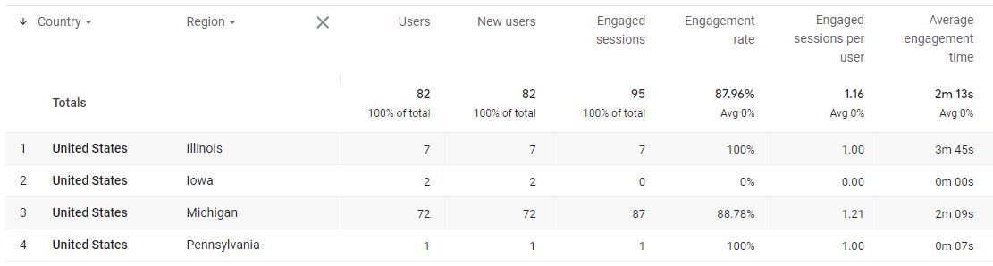
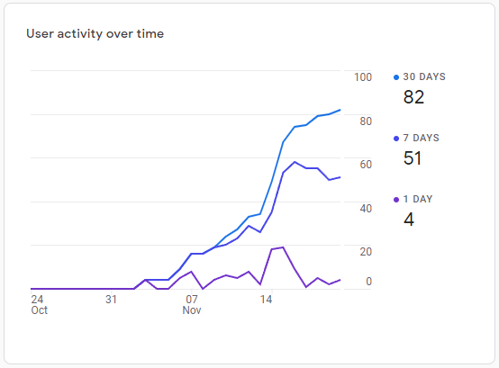
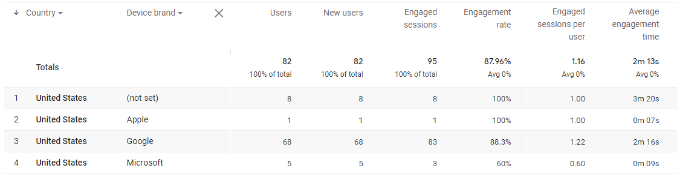
Outcomes/Results?
www.rsrafvp.com
Where are users coming from?
How many users?
What types of devices are hitting the site?
CIS693 – Final Project Presentation
Kirk Hedlich, Dec. 16, 2021
Notes:
Shown here are metrics from the live site: www.rsrafvp.com
The site went live on Nov 1 with Release 1
The site was update on Nov 20 with Release 2 functionality
Metrics are being tracked for pages used, locations visitors are from, devices using the site
Real users, real patient outcomes
Making a simple assessment much easier through software engineering and cloud computing services.

